Slide 1
Full-Stack Portfolio
By: Spencer Yates

Slide 2
The Problem
Slow updating process
Have to edit code every time

Slide 3
Goals
Full-Stack Application
24/7 Web Hosting
Admin Panel for easy editing

Slide 4




Tools

Slide 5
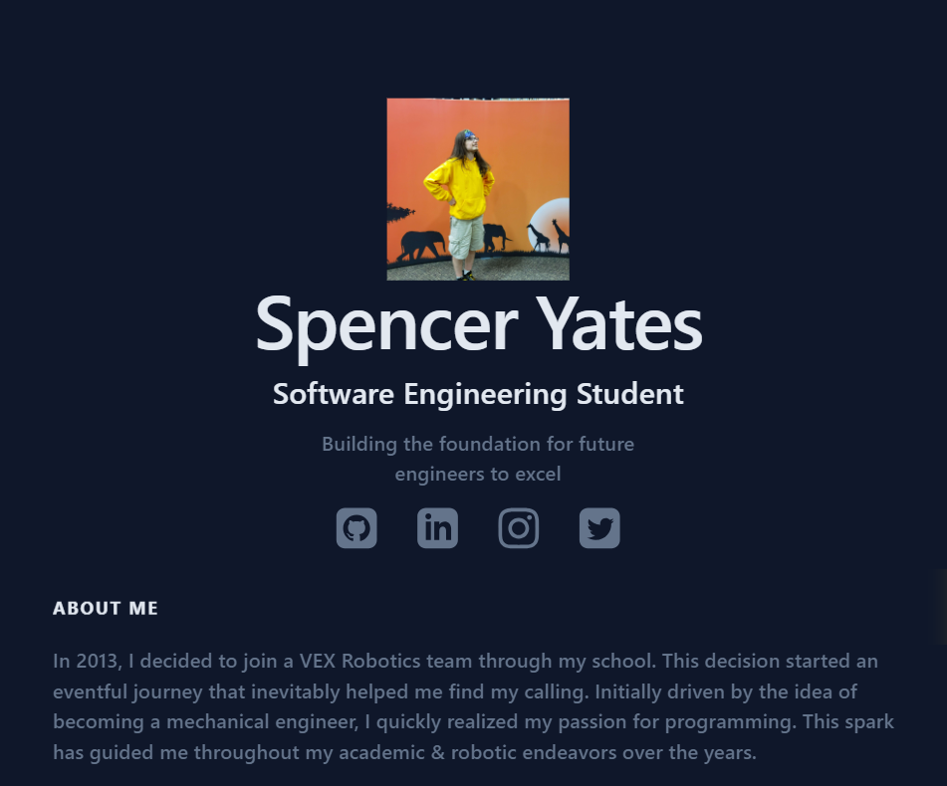
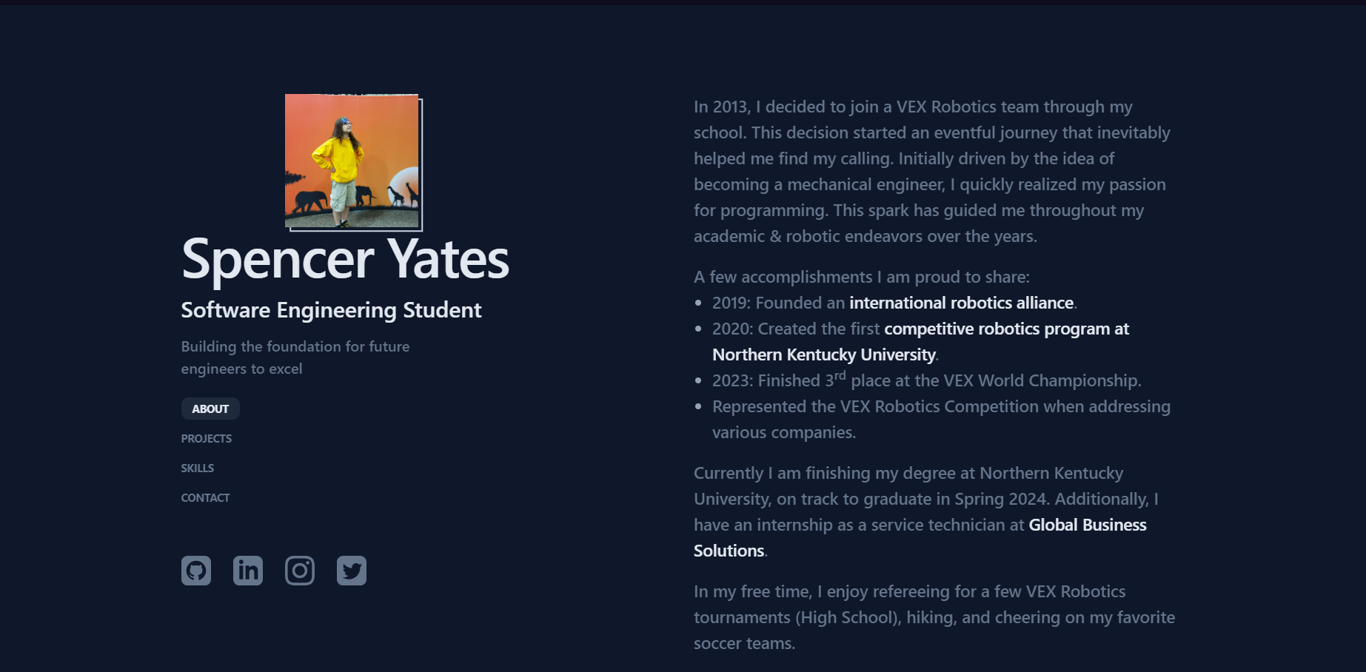
Current Iteration
Initial LoC: 1,249

Slide 6
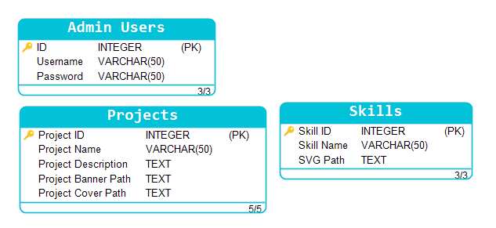
Project Architecture

Slide 7
The Future Plans
Redesign front-end to be more pleasing and unique
Allow to host projects under the same domain

Slide 8

Milestones
Milestone 1 Goal: Design Back-end Completed: 03/19/24
Milestone 2 Goal: Switch host used for deployment Deadline: 03/31/24

Slide 9
Questions?

